Slide 1
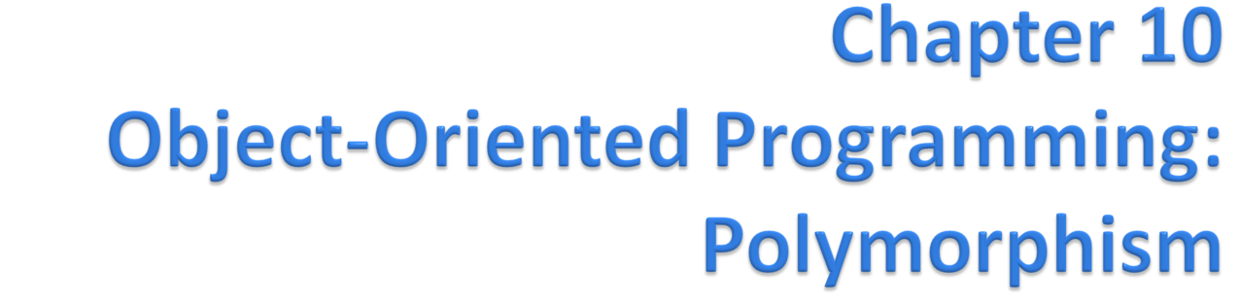
Java™ How to Program, 9/e
© Copyright 1992-2012 by Pearson Education, Inc. All Rights Reserved.

Slide 2
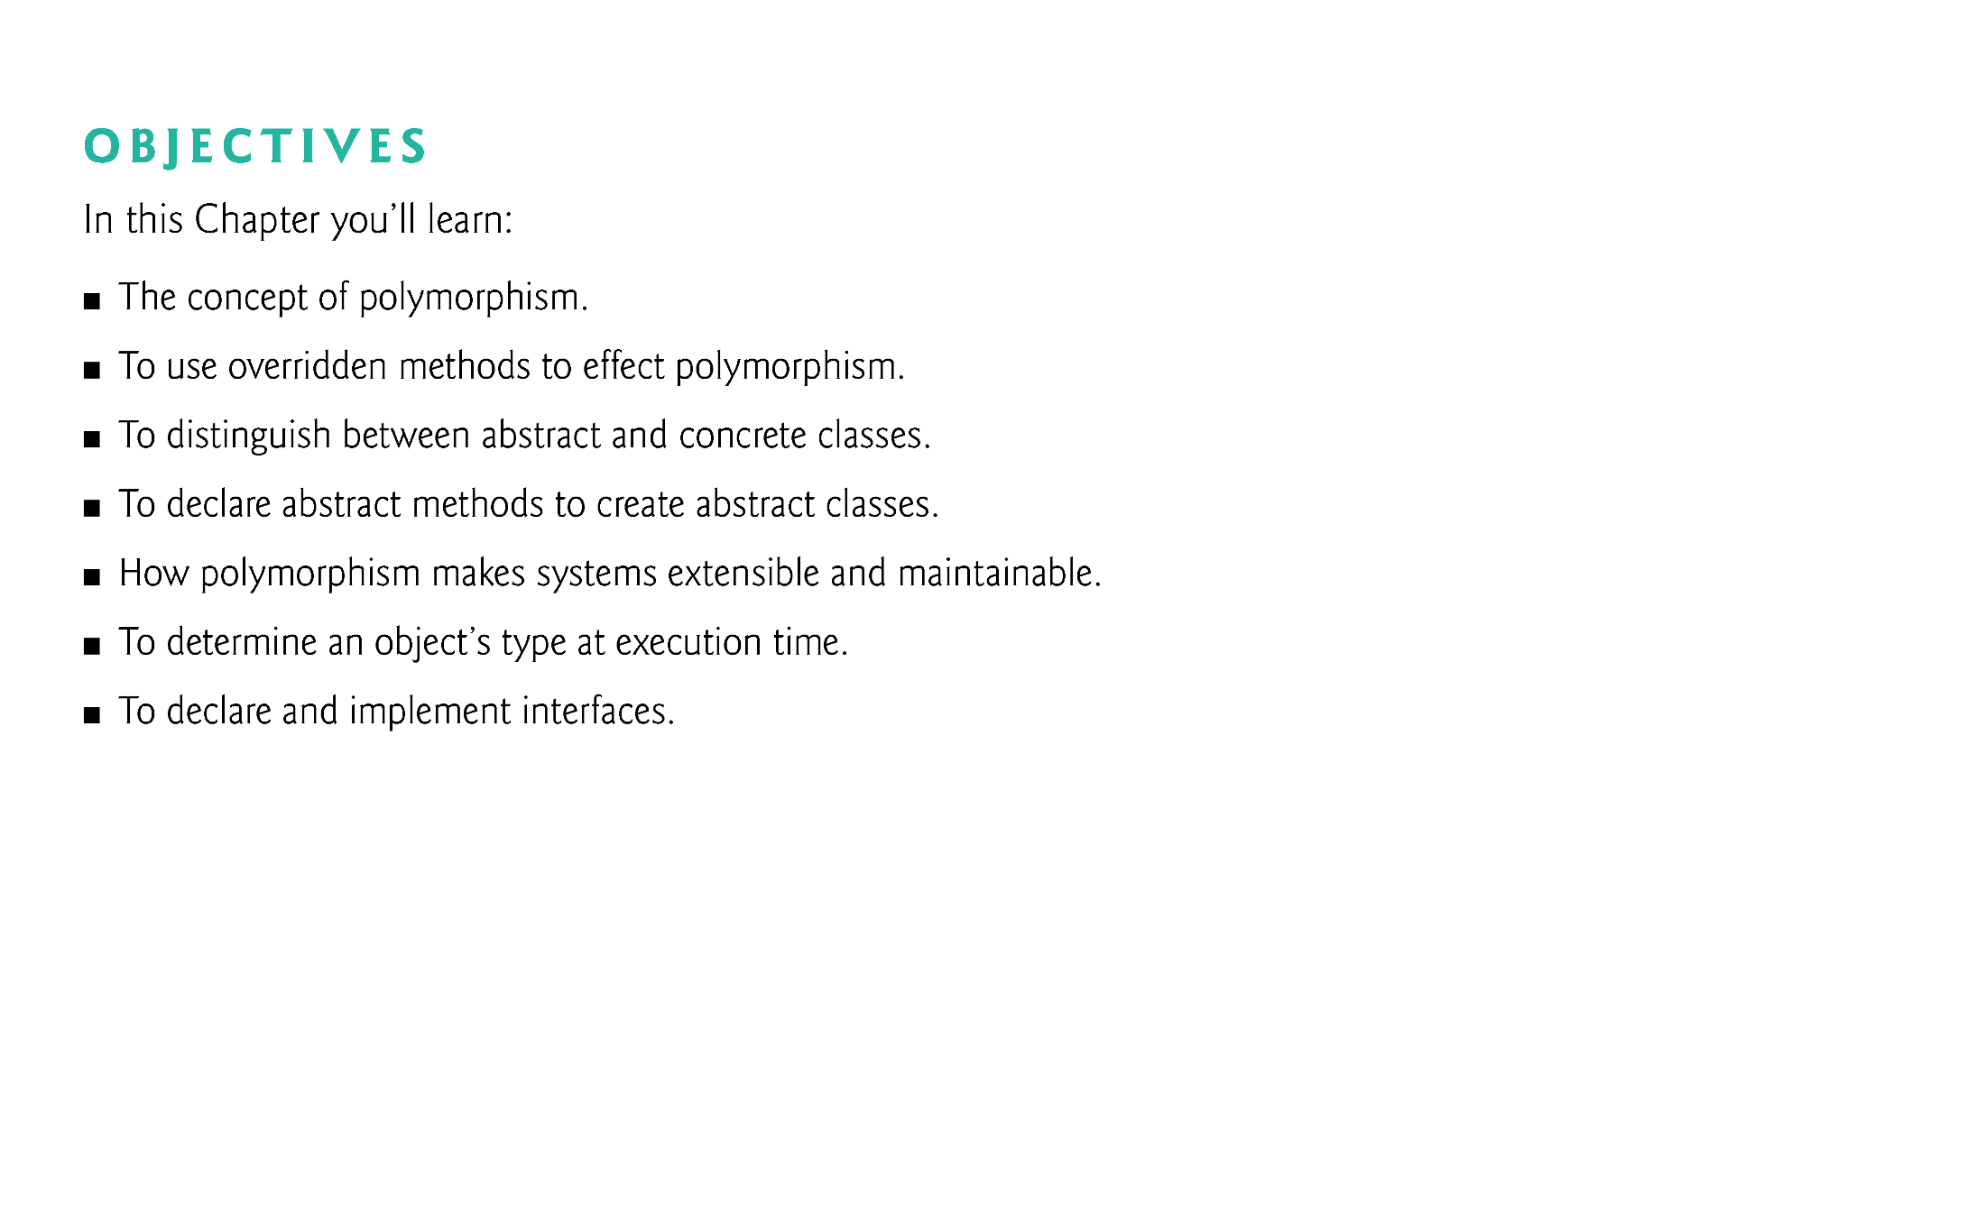
© Copyright 1992-2012 by Pearson Education, Inc. All Rights Reserved.

Slide 3
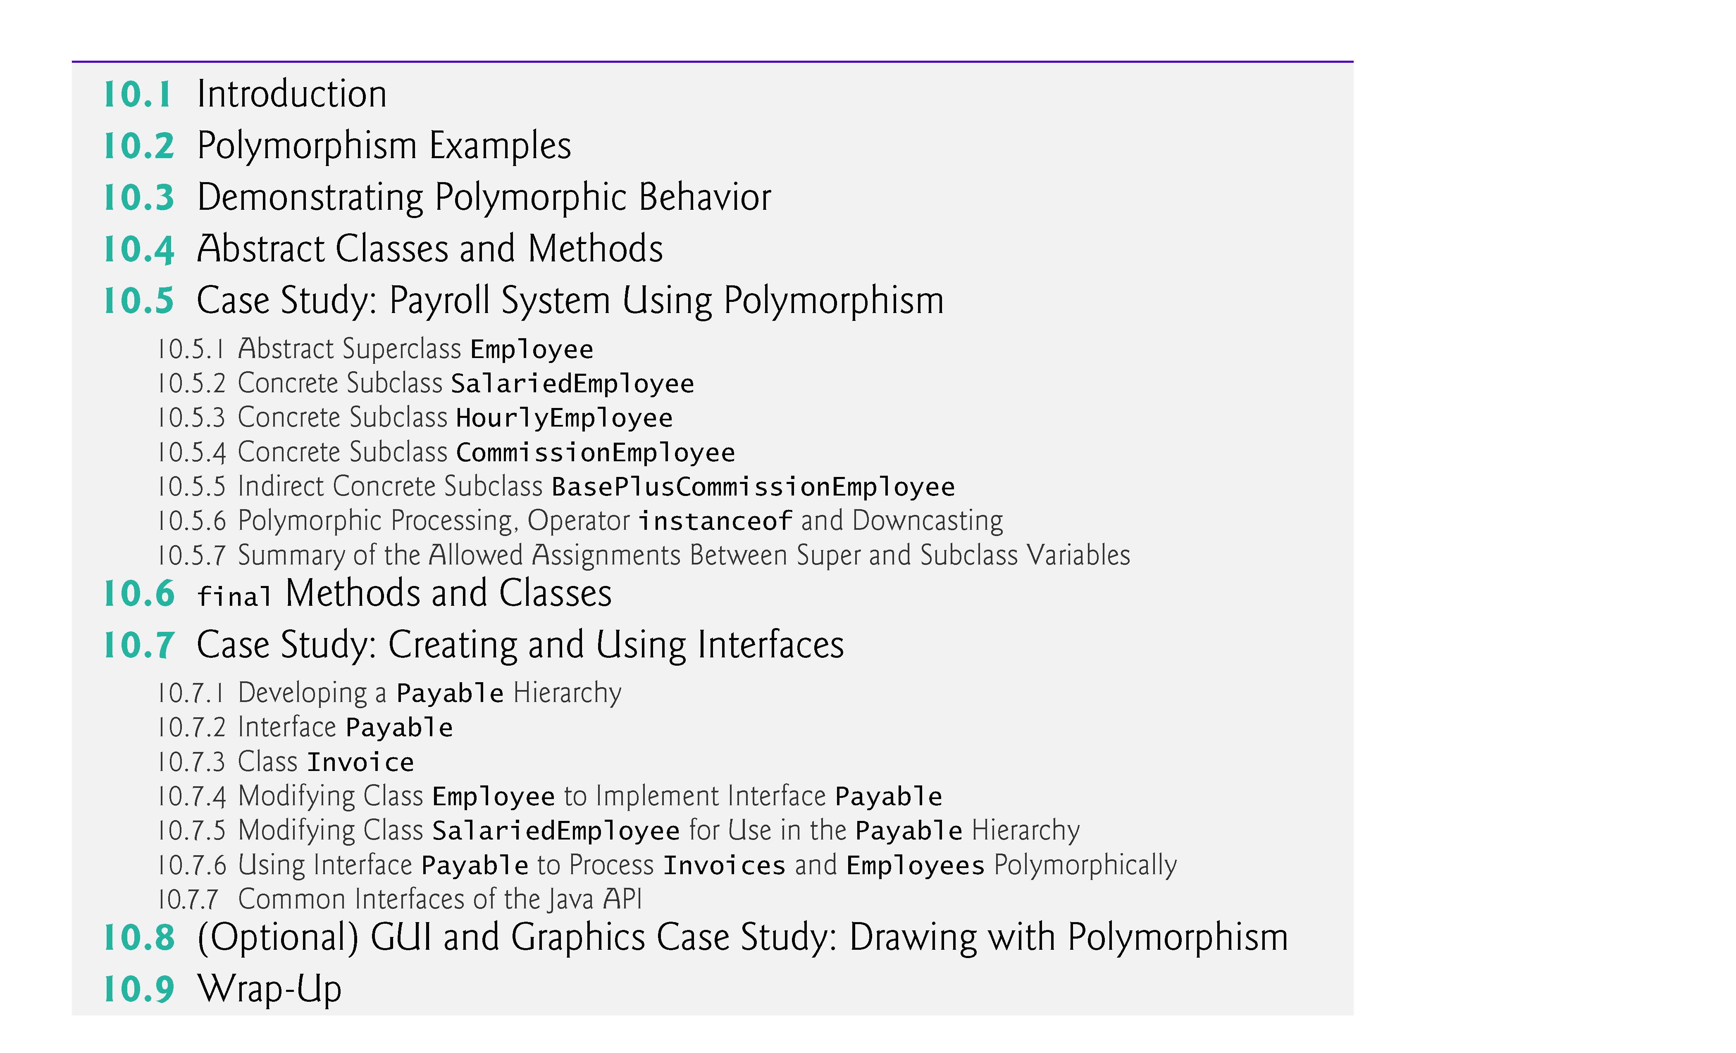
© Copyright 1992-2012 by Pearson Education, Inc. All Rights Reserved.

Slide 4

Polymorphism
  Enables you to “program in the general” rather than “program in the specific.”
  Polymorphism enables you to write programs that process objects that share the same superclass as if they’re all objects of the superclass; this can simplify programming.
© Copyright 1992-2012 by Pearson Education, Inc. All Rights Reserved.

Slide 5

Example: Suppose we create a program that simulates the movement of several types of animals for a biological study. Classes Fish, Frog and Bird represent the three types of animals under investigation.
  Each class extends superclass Animal, which contains a method move and maintains an animal’s current location as x-y coordinates. Each subclass implements method move.
  A program maintains an Animal array containing references to objects of the various Animal subclasses. To simulate the animals’ movements, the program sends each object the same message once per second—namely, move.
© Copyright 1992-2012 by Pearson Education, Inc. All Rights Reserved.

Slide 6
Each specific type of Animal responds to a move message in a unique way:
  a Fish might swim three feet
  a Frog might jump five feet
  a Bird might fly ten feet.
The program issues the same message (i.e., move) to each animal object, but each object knows how to modify its x-y coordinates appropriately for its specific type of movement.
Each object knows, how to “do the right thing” in response to the same method call – This is the key concept of polymorphism.
The same message sent to a variety of objects has “many forms” of results—hence the term polymorphism.
  Poly – multiple, Morph – form/shape
© Copyright 1992-2012 by Pearson Education, Inc. All Rights Reserved.

Slide 7
With polymorphism, we can design and implement systems that are easily extensible
  New classes can be added with little or no modification to the general portions of the program, as long as the new classes are part of the inheritance hierarchy that the program processes generically.
  The only parts of a program that must be altered to accommodate new classes are those that require direct knowledge of the new classes that we add to the hierarchy.
    E.g. if some subclass-specific functionality is needed which is not included in the general superclass
© Copyright 1992-2012 by Pearson Education, Inc. All Rights Reserved.

Slide 8

Example: Quadrilaterals
  If Rectangle is derived from Quadrilateral, then a Rectangle object is a more specific version of a Quadrilateral.
  Any operation that can be performed on a Quadrilateral can also be performed on a Rectangle, such as area, perimeter etc.
  These operations can also be performed on other Quadrilaterals, such as Squares, Parallelograms and Trapezoids.
  Polymorphism occurs when a program calls a method through a superclass Quadrilateral variable.
    At execution time, the correct subclass version of the method is called, based on the type of the reference stored in the superclass variable – a process called late binding or dynamic binding.
© Copyright 1992-2012 by Pearson Education, Inc. All Rights Reserved.

Slide 9

// Class 1
class Parent {
// Method of parent class
void Print() {
System.out.println("parent class");
}}
// Class 2
class subclass1 extends Parent {
//Overrided Method
void Print() {
System.out.println("subclass1");
}}
// Class 3
class subclass2 extends Parent {
//Overrided Method
void Print() {
System.out.println("subclass2");
}}
// Class 4
// Main class
class TestClass {
// Main driver method
public static void main(String[] args) {
// Creating object of class 1
Parent a;
// Now we will be calling print methods // inside main() method
a = new subclass1();
if(a instanceof subclass1)
a.Print();
a = new subclass2();
if(a instanceof subclass2)
a.Print(); }}
© Copyright 1992-2012 by Pearson Education, Inc. All Rights Reserved.

Slide 10

Abstract classes
  Sometimes there exist some missing pieces in the design of a class, therefore it’s useful to declare classes for which you never intend to create objects.
  Used only as superclasses in inheritance hierarchies, so they are sometimes called abstract superclasses.
  Cannot be used to instantiate objects—abstract classes are incomplete.
  Subclasses must declare the “missing pieces” to become “concrete” classes, from which you can instantiate objects; otherwise, these subclasses, too, will be abstract.
An abstract class provides a superclass from which other classes can inherit and thus share a common design.
© Copyright 1992-2012 by Pearson Education, Inc. All Rights Reserved.

Slide 11

Classes that can be used to instantiate objects are called concrete classes.
  Such classes provide implementations of every method they declare.
Abstract superclasses are too general to create real objects—they specify only what is common among subclasses.
Concrete classes provide the specifics that make it reasonable to instantiate objects.
Not all hierarchies necessarily contain abstract classes.
© Copyright 1992-2012 by Pearson Education, Inc. All Rights Reserved.

Slide 12
You make a class abstract by declaring it with keyword abstract.
An abstract class contains one or more abstract methods.
  An abstract method is the one with keyword abstract in its declaration, as in
    public abstract void draw(); // abstract method
Abstract methods do not provide implementations.
A class that contains abstract methods MUST be declared an abstract class even if that class contains some concrete (non-abstract) methods.
Each concrete subclass of an abstract superclass also must provide concrete implementations of each of the superclass’s abstract methods, otherwise that subclass also becomes abstract
Constructors and static methods cannot be declared abstract.
© Copyright 1992-2012 by Pearson Education, Inc. All Rights Reserved.

Slide 13
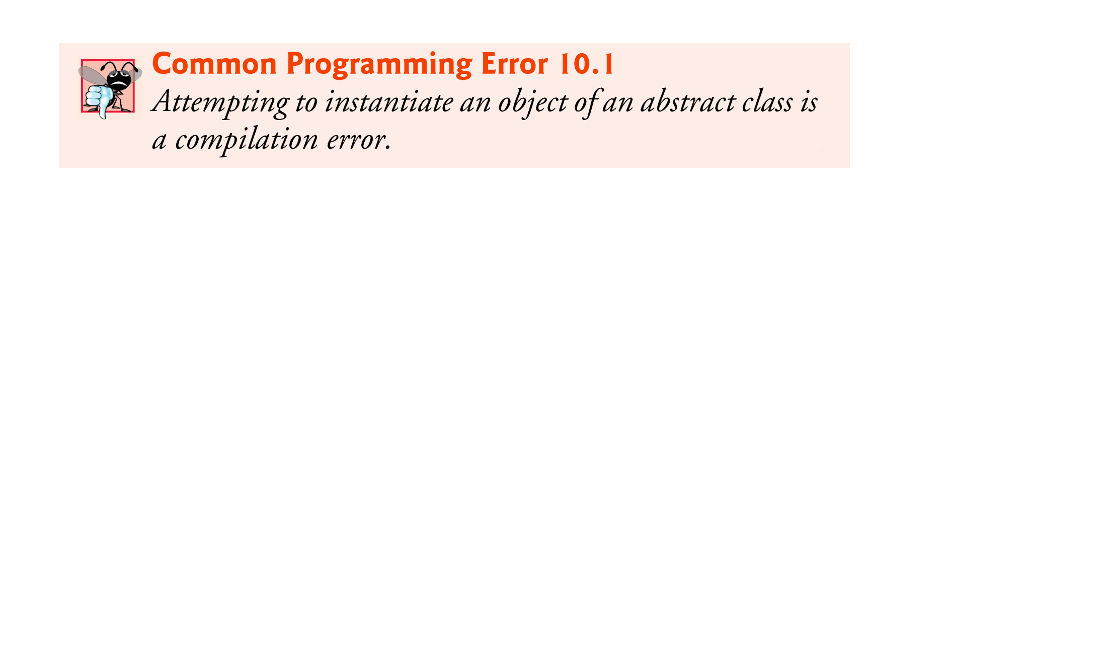
© Copyright 1992-2012 by Pearson Education, Inc. All Rights Reserved.

Slide 14
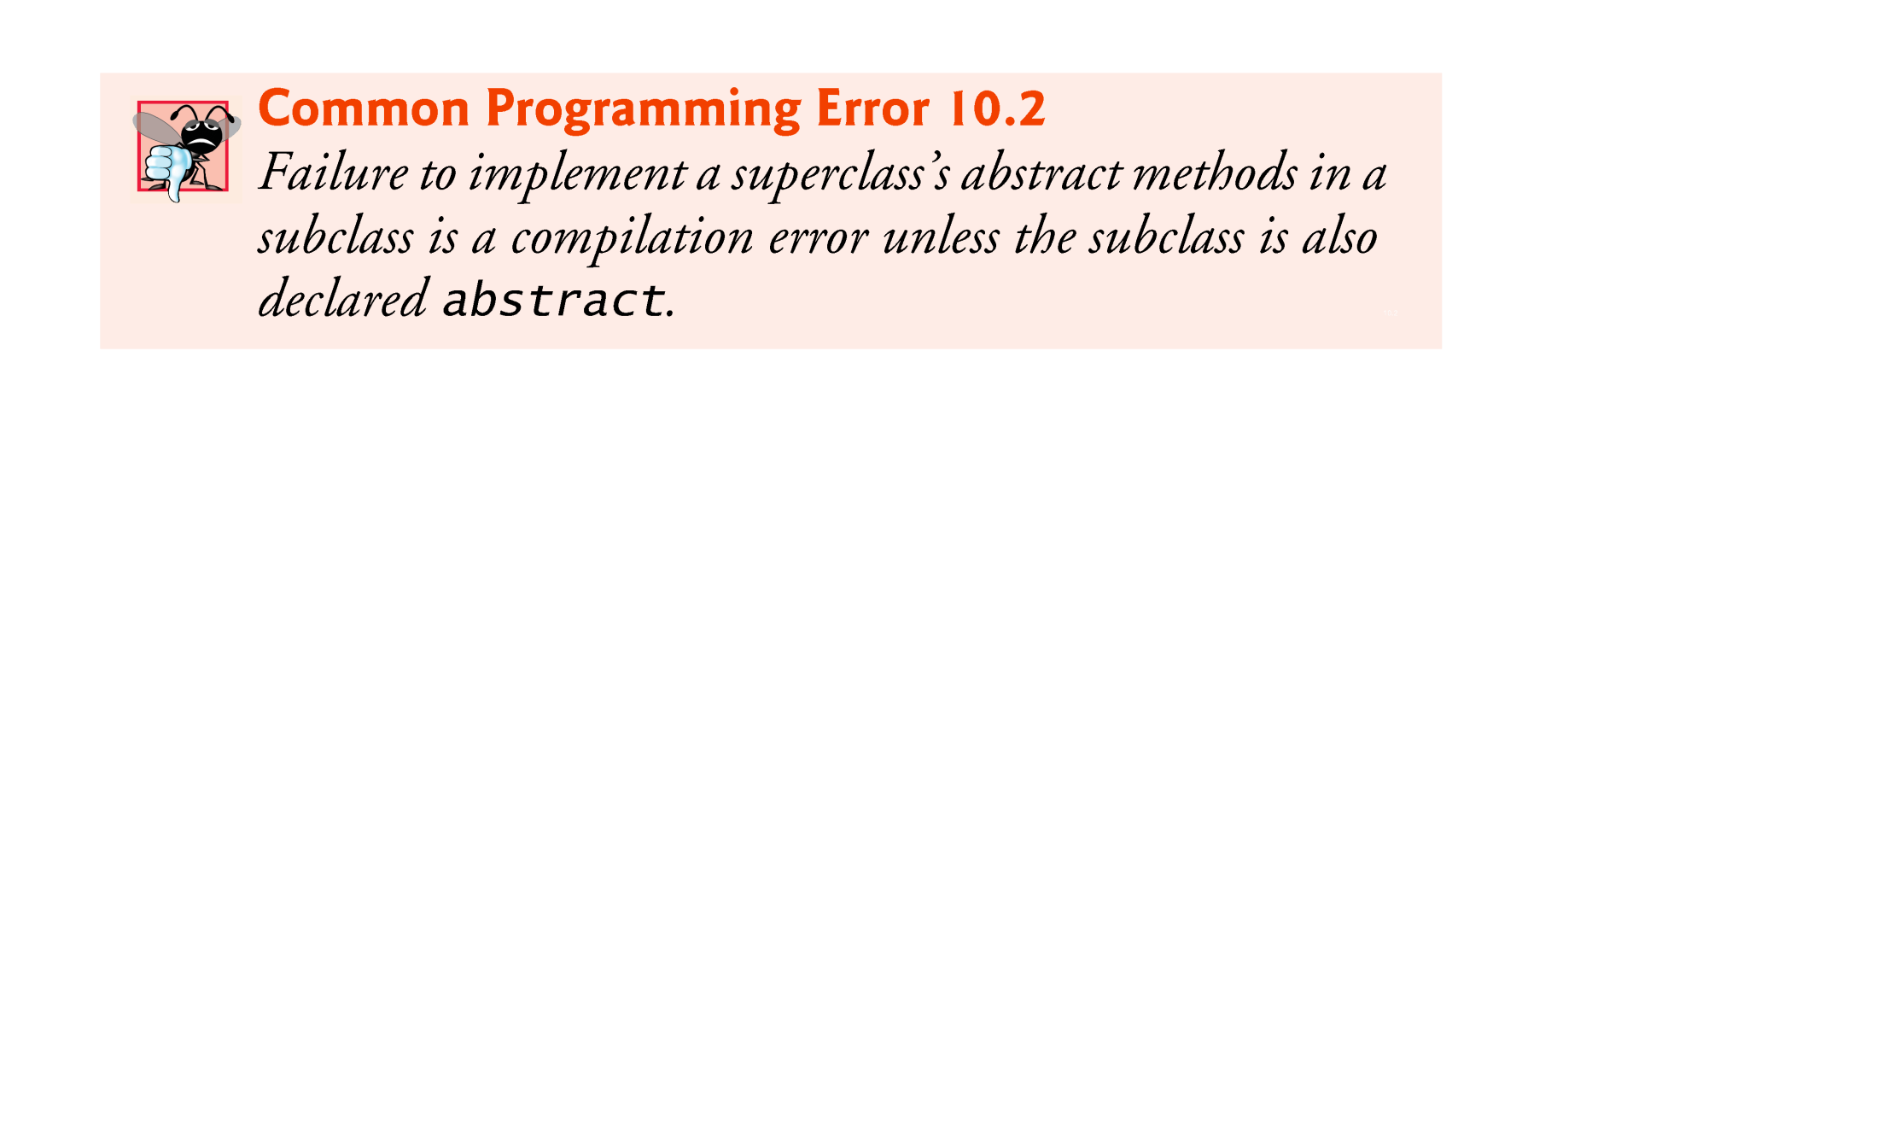
© Copyright 1992-2012 by Pearson Education, Inc. All Rights Reserved.

Slide 15
You cannot instantiate objects of abstract superclasses, but you can use abstract superclasses to declare variables
  These can hold references to objects of any concrete class derived from those abstract superclasses.
  Programs typically use such variables to manipulate subclass objects polymorphically.
© Copyright 1992-2012 by Pearson Education, Inc. All Rights Reserved.

Slide 16
// Abstract class
abstract class Animal {
abstract void sound(); // Abstract method
void sleep() { // Concrete method
System.out.println("This animal sleeps.");
}
}
// Subclass providing implementation for abstract method
class Dog extends Animal {
void sound() {
System.out.println("The dog barks.");
}
}
public class Main {
public static void main(String[] args) {
Animal myDog = new Dog(); // Polymorphism
myDog.sound(); // Output: The dog barks.
myDog.sleep(); // Output: This animal sleeps.
}
}
© Copyright 1992-2012 by Pearson Education, Inc. All Rights Reserved.

Slide 17

© Copyright 1992-2012 by Pearson Education, Inc. All Rights Reserved.

Slide 18
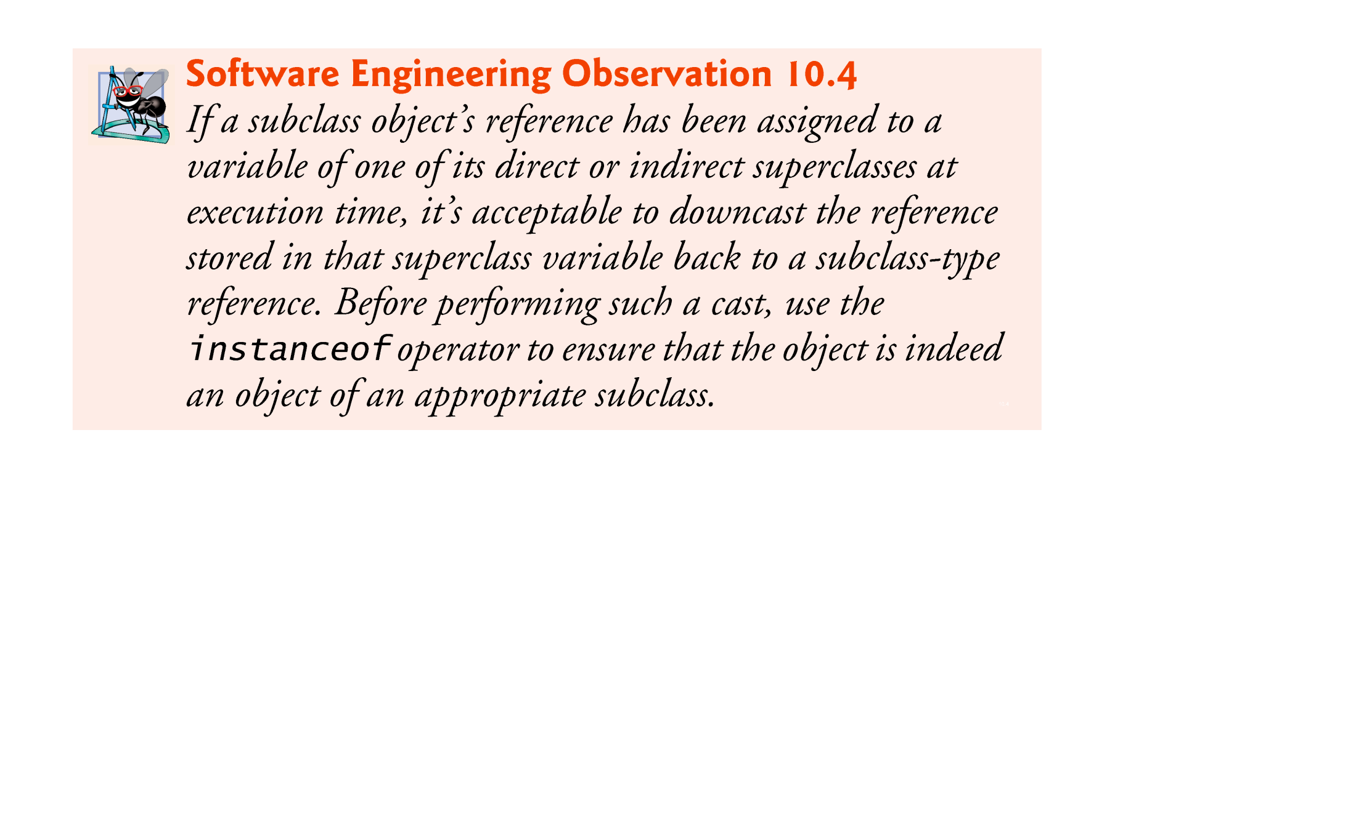

Slide 19
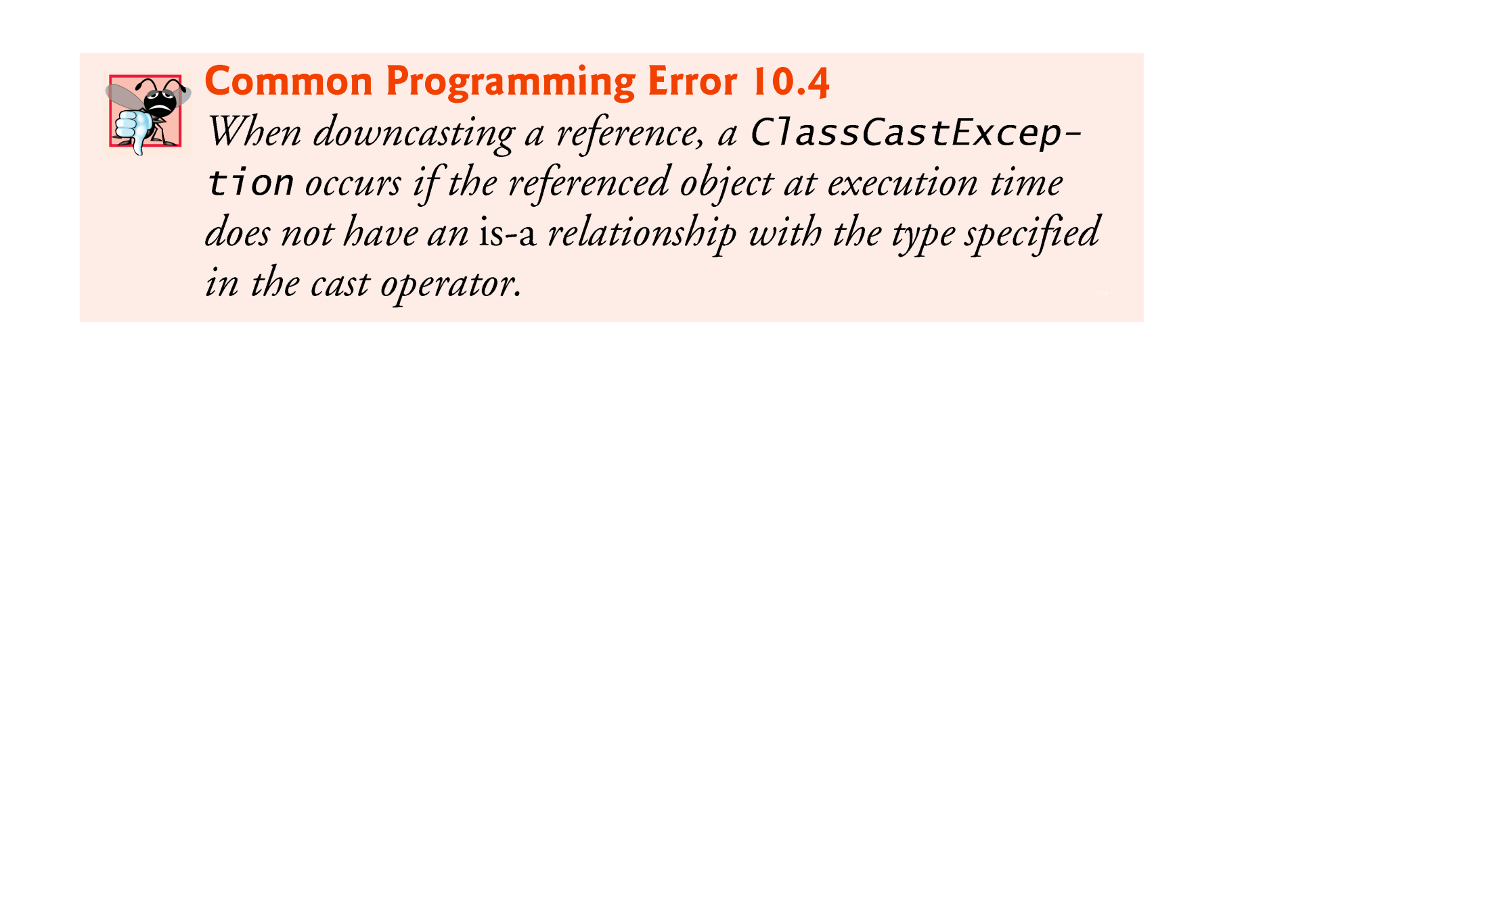

Slide 20

There are four ways to assign superclass and subclass references to variables of superclass and subclass types.
Assigning a superclass reference to a superclass variable is straightforward.
Assigning a subclass reference to a subclass variable is straightfor-ward.
Assigning a subclass reference to a superclass variable is safe, because the subclass object is an object of its superclass.
  The superclass variable can be used to refer only to superclass members.
  If this code refers to subclass-only members through the superclass variable, the compiler reports errors.
© Copyright 1992-2012 by Pearson Education, Inc. All Rights Reserved.

Slide 21
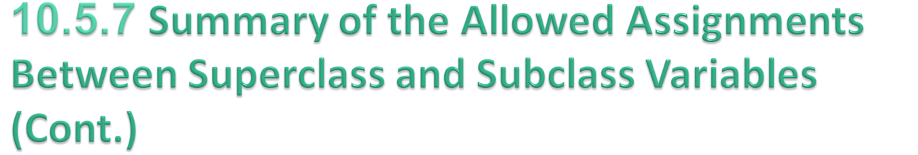
Attempting to assign a superclass reference to a subclass variable is a compilation error.
  To avoid this error, the superclass reference must be cast to a subclass type explicitly.
  At execution time, if the object to which the reference refers is not a subclass object, an exception will occur.
  Use the instanceof operator to ensure that such a cast is performed only if the object is a subclass object.
© Copyright 1992-2012 by Pearson Education, Inc. All Rights Reserved.

Slide 22

A method can be declared final by adding final keyword before method definition
A final method in a superclass cannot be overridden in a subclass.
  Methods that are declared private are implicitly final, because it’s not possible to override them in a subclass.
  Methods that are declared static are implicitly final.
  A final method’s declaration can never change, so all subclasses use the same methmethods are resolved atod implementation, and calls to final compile time—this is known as static binding.
© Copyright 1992-2012 by Pearson Education, Inc. All Rights Reserved.

Slide 23

A class can be declared final by adding final keyword before class declaration
A final class cannot be a superclass (i.e., a class cannot extend a final class).
  All methods in a final class are implicitly final.
Class String is an example of a final class.
Making the class final also prevents programmers from creating subclasses that might bypass security restrictions.
© Copyright 1992-2012 by Pearson Education, Inc. All Rights Reserved.

Slide 24

© Copyright 1992-2012 by Pearson Education, Inc. All Rights Reserved.

Slide 25
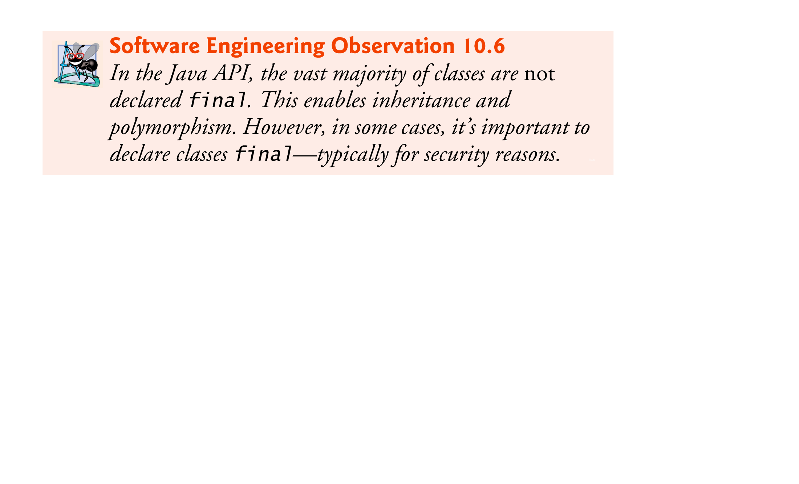
© Copyright 1992-2012 by Pearson Education, Inc. All Rights Reserved.

Slide 26
Once a class implements an interface, all objects of that class have an is-a relationship with the interface type, and all objects of the class are guaranteed to provide the functionality described by the interface.
This is true of all subclasses of that class as well.
Interfaces are particularly useful for assigning common functionality to possibly unrelated classes.
  Allows objects of unrelated classes to be processed polymorphically—objects of classes that implement the same interface can respond to all of the interface method calls.
© Copyright 1992-2012 by Pearson Education, Inc. All Rights Reserved.

Slide 27

An interface is a class like construct that contains only constants and abstract methods.
In many ways, an interface is similar to an abstract class, but the intent of an interface is to specify common behavior for objects.
For example, you can specify that the objects are comparable, edible, cloneable using appropriate interfaces.
Each interface method must be declared in all the classes that explicitly implement the interface.
It is used to achieve abstraction and multiple inheritance in Java.
© Copyright 1992-2012 by Pearson Education, Inc. All Rights Reserved.

Slide 28
An interface describes a set of methods that can be called on an object, but does not provide concrete implementations for all the methods.
You can declare classes that implement (i.e., provide concrete implementations for the methods of) one or more interfaces.
Each interface method must be declared in all the classes that explicitly implement the interface.
Each interface method must be declared in all the classes that explicitly implement the interface.
© Copyright 1992-2012 by Pearson Education, Inc. All Rights Reserved.

Slide 29

In Java, the Cloneable interface is a marker interface used to indicate that a class allows creating an exact copy of its objects. It is part of java.lang package and is primarily used with the Object.clone() method to create duplicates of objects.
It does not contain any methods (Marker Interface).
Its main purpose is to signal to the Object.clone() method that the objects of this class can be safely cloned.
If a class implements Cloneable, calling clone() on its objects will create a shallow copy.
Syntax
class ClassName implements Cloneable {
// class fields and methods
}
© Copyright 1992-2012 by Pearson Education, Inc. All Rights Reserved.

Slide 30
To define a custom class that implements the Cloneable interface, the class must override the clone() method in the Object class. The following code defines a class named House that implements Cloneable and Comparable.

Slide 31
public class House implements Cloneable, Comparable<House> {
private int id;
private double area;
private java.util.Date whenBuilt;
public House(int id, double area) {
this.id = id;
this.area = area;
whenBuilt = new java.util.Date();
}
public int getId() {
return id;
}
public double getArea() {
return area;
}
public java.util.Date getWhenBuilt() {
return whenBuilt;
}
@Override /** Override the protected clone method defined in
the Object class, and strengthen its accessibility */
public Object clone() {
// Perform a shallow copy
House houseClone = new House(id, area);
// Deep copy on whenBuilt
houseClone.whenBuilt = new java.util.Date();
houseClone.getWhenBuilt().setTime(whenBuilt.getTime());
return houseClone;
}
@Override // Implement the compareTo method defined in Comparable
public int compareTo(House o) {
if (area > o.area)
return 1;
else if (area < o.area)
return -1;
else
return 0;
}
}
© Copyright 1992-2012 by Pearson Education, Inc. All Rights Reserved.

Slide 32
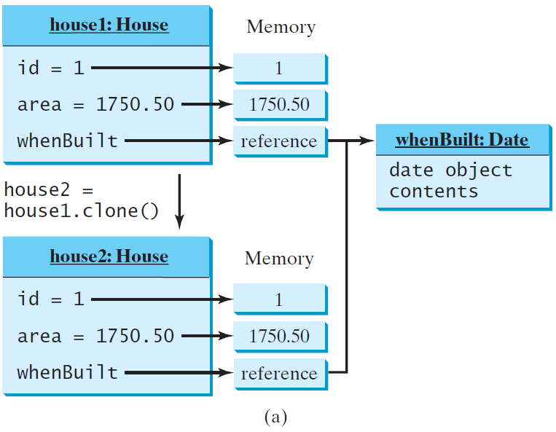
House house1 = new House(1, 1750.50);
House house2 = (House)house1.clone();
Shallow Copy

Slide 33
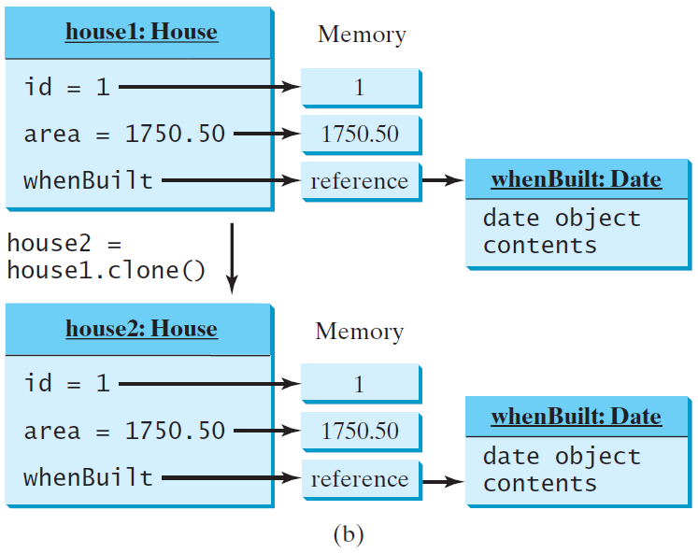
House house1 = new House(1, 1750.50);
House house2 = (House)house1.clone();
Deep Copy

Slide 34
import java.io.*;
// Interface Declared
interface testInterface {
// public, static and final
final int a = 10;
// public and abstract
void display();
}
// Class implementing interface
class TestClass implements testInterface {
// Implementing the capabilities of Interface
public void display(){
System.out.println("Geek");
}
}
class Main{
public static void main(String[] args){
TestClass t = new TestClass();
t.display();
System.out.println(t.a);
}
}
© Copyright 1992-2012 by Pearson Education, Inc. All Rights Reserved.

Slide 35

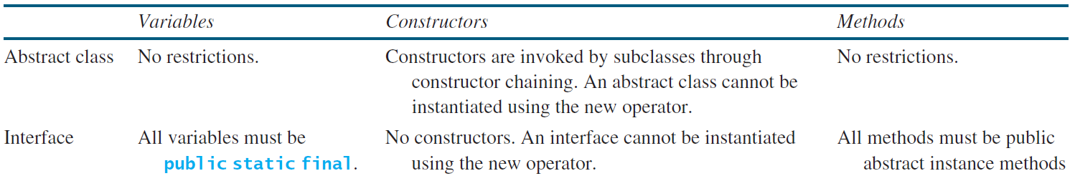
  In an interface, the data must be constants; an abstract class can have all types of data.
  Each method in an interface has only a signature without implementation; an abstract class can have concrete methods.

Slide 36
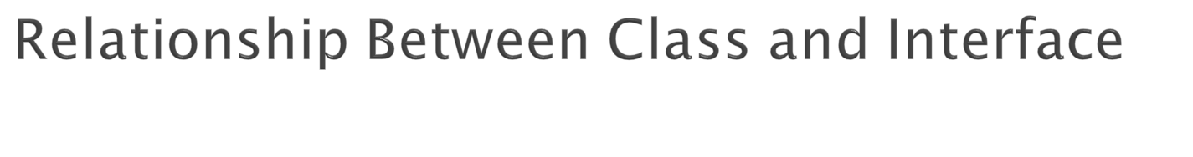
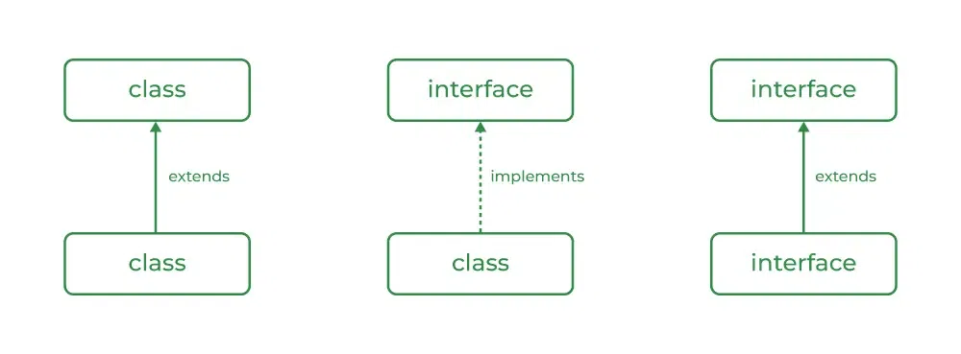
A class can extend another class and similarly, an interface can extend another interface. However, only a class can implement an interface and the reverse (an interface implementing a class) is not allowed.
© Copyright 1992-2012 by Pearson Education, Inc. All Rights Reserved.

Slide 37

Use a Class when:
Use a class when you need to represent a real-world entity with attributes (fields) and behaviors (methods).
Use a class when you need to create objects that hold state and perform actions
Classes are used for defining templates for objects with specific functionality and properties.
Use an Interface when:
Use an interface when you need to define a contract for behavior that multiple classes can implement.
Interface is ideal for achieving abstraction and multiple inheritance.
Implementation: To implement an interface, we use the keyword implements
© Copyright 1992-2012 by Pearson Education, Inc. All Rights Reserved.

Slide 38
import java.io.*;
interface Vehicle {
// Abstract methods defined
void changeGear(int a);
void speedUp(int a);
void applyBrakes(int a);
}
// Class implementing vehicle interface
class Bicycle implements Vehicle{
int speed;
int gear;
// Change gear
@Override
public void changeGear(int newGear){
gear = newGear;
}
// Increase speed
@Override
public void speedUp(int increment){
speed = speed + increment;
}
// Decrease speed
@Override
public void applyBrakes(int decrement){
speed = speed - decrement;
}
public void printStates() {
System.out.println("speed: " + speed
+ " gear: " + gear);
}
}
// Class implementing vehicle interface
class Bike implements Vehicle {
int speed;
int gear;
// Change gear
@Override
public void changeGear(int newGear){
gear = newGear;
}
// Increase speed
@Override
public void speedUp(int increment){
speed = speed + increment;
}
// Decrease speed
@Override
public void applyBrakes(int decrement){
speed = speed - decrement;
}
public void printStates() {
System.out.println("speed: " + speed
+ " gear: " + gear);
}
}
public class Main
{
public static void main (String[] args)
{
// Instance of Bicycle(Object)
Bicycle bicycle = new Bicycle();
bicycle.changeGear(2);
bicycle.speedUp(3);
bicycle.applyBrakes(1);
System.out.print("Bicycle present state : ");
bicycle.printStates();
// Instance of Bike (Object)
Bike bike = new Bike();
bike.changeGear(1);
bike.speedUp(4);
bike.applyBrakes(3);
System.out.print("Bike present state : ");
bike.printStates();
}
}
© Copyright 1992-2012 by Pearson Education, Inc. All Rights Reserved.

Slide 39
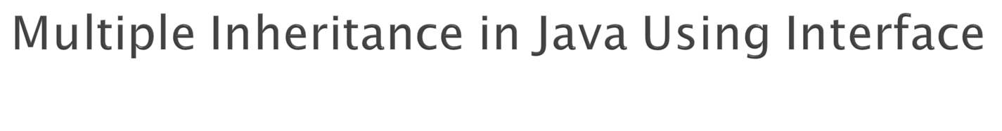
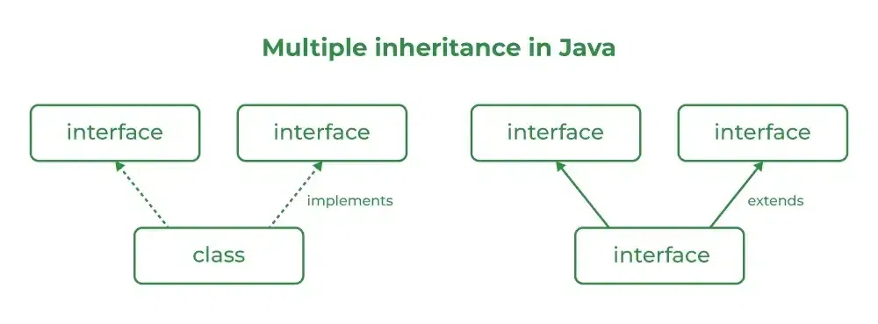
Java does not support multiple inheritance with classes to avoid ambiguity, but it supports multiple inheritance using interfaces.
© Copyright 1992-2012 by Pearson Education, Inc. All Rights Reserved.

Slide 40
import java.io.*;
// Add interface
interface Add{
int add(int a,int b);
}
// Sub interface
interface Sub{
int sub(int a,int b);
}
// Calculator class implementing Add and Sub
class Cal implements Add , Sub
{
// Method to add two numbers
public int add(int a,int b){
return a+b;
}
// Method to sub two numbers
public int sub(int a,int b){
return a-b;
}
}
public class GFG{
// Main Method
public static void main (String[] args){
// instance of Cal class
Cal x = new Cal();
System.out.println("Addition : " + x.add(2,1));
System.out.println("Substraction : " + x.sub(2,1));
}
}
© Copyright 1992-2012 by Pearson Education, Inc. All Rights Reserved.

Slide 41

Interfaces can define methods with default implementations.
Useful for adding new methods to interfaces without breaking existing implementations.
interface TestInterface
{
final int a = 10;
default void display() {
System.out.println("hello");
}
}
// A class that implements the interface.
class TestClass implements TestInterface
{
// Driver Code
public static void main (String[] args) {
TestClass t = new TestClass();
t.display();
}
}
© Copyright 1992-2012 by Pearson Education, Inc. All Rights Reserved.

Slide 42

Interfaces can now include static methods.
These methods are called directly using the interface name and are not inherited by implementing classes.
interface TestInterface
{
final int a = 10;
static void display()
{
System.out.println("hello");
}
}
// A class that implements the interface.
class TestClass implements TestInterface
{
// Driver Code
public static void main (String[] args)
{
TestInterface.display();
}
}
© Copyright 1992-2012 by Pearson Education, Inc. All Rights Reserved.

Slide 43

Interface can now include private methods.
Private methods are defined within the interface but it cannot be accessed by the implementing classes.
Private methods cannot be overridden by implementing classes as they are not inherited.
interface Vehicle {
// Private method for internal use
private void startEngine() {
System.out.println("Engine started.");
}
// Default method that uses the private method
default void drive() {
// Calls the private method
startEngine();
System.out.println("Vehicle is now driving.");
}
}
class Car implements Vehicle {
// Car class implements Vehicle interface and inherits the default method 'drive'
}
public class Main {
public static void main(String[] args) {
Car car = new Car();
// This will call the default method, which in turn calls the private method
car.drive();
}
}
© Copyright 1992-2012 by Pearson Education, Inc. All Rights Reserved.

Slide 44

One interface can inherit another by the use of keyword extends. When a class implements an interface that inherits another interface, it must provide an implementation for all methods required by the interface inheritance chain.
interface A {
void method1();
void method2();
}
// B now includes method1 and method2
interface B extends A {
void method3();
}
// the class must implement all method of A and B.
class GFG implements B
{ public void method1() {
System.out.println("Method 1");
}
public void method2() {
System.out.println("Method 2");
}
public void method3() {
System.out.println("Method 3");
}
public static void main(String[] args){
// Instance of GFG class created
GFG x = new GFG();
// All Methods Called
x.method1();
x.method2();
x.method3();
}
}
© Copyright 1992-2012 by Pearson Education, Inc. All Rights Reserved.

Slide 45
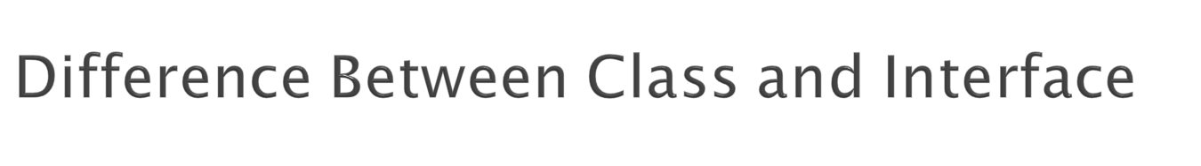
Although Class and Interface seem the same there are certain differences between Classes and Interface. The major differences between a class and an interface are mentioned below:
© Copyright 1992-2012 by Pearson Education, Inc. All Rights Reserved.

Slide 46
Features | Class | Interface
Instantiation | In class, you can create an object. | In an interface, you can't create an object
Variables | Class can have instance variables | Variables are public static final (constants only).
Methods | Class can have concrete methods | In an interface, methods are abstract by default
Inheritance | It supports single inheritance | Supports multiple inheritance
Constructors | Can have constructors. | No constructors allowed.
Access Modifiers | Supports private, protected, public, default. | In an interface, all members are public by default
Keyword | Defined using class. | Defined using interface.
Default Methods | It does not support default methods | It supports default methods(JDK 8+)
Static Methods | Can have static methods. | Supports static methods (JDK 8+)
Private Methods | Can have private methods. | Supports private methods (JDK 9+).
Main Method | Can have main() for execution. | Can have main() (since JDK 8, as static methods are allowed).
© Copyright 1992-2012 by Pearson Education, Inc. All Rights Reserved.

